Slide 1
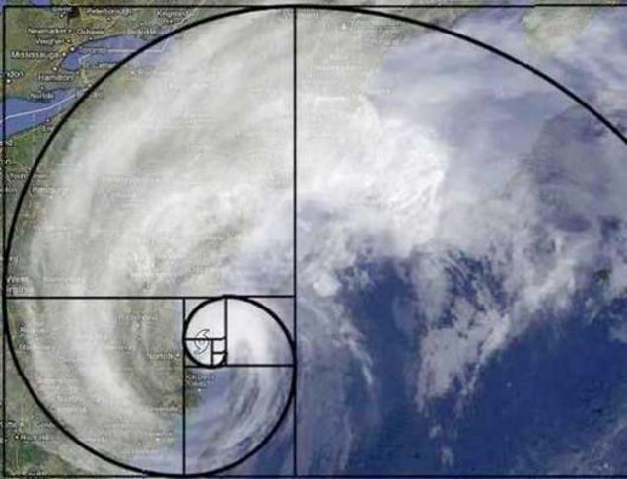

Harmonic Proportion: The Golden Section and other Systems of Dynamic Composition, and LeonardoDecoded!

Slide 2
What Really Makes Great Art?
Paint what you feel a passion for. Paint because you feel something about what you are attempting.
Familiarity with the subject is essential. The more you paint, the deeper your feelings for the subject becomes.
Take risks. Approach every artistic effort as an experiment.
A painting’s technique, color, and perspective may all be excellent, yet the painting will fail unless its composition succeeds! This is what we will look at in some depth.

Slide 3
Is Mastering Composition in Art Really Necessary?
Now that is the real question.
Mastering composition is essential for any artist who wants to go further on their journey and create better artwork. When learning to paint or draw, it’s easy to forget about composition in the face of various painting techniques and styles. However, composition in art is a cornerstone that cannot be replaced. With it, you can create stories without words that grasp the viewer’s heart and stay etched in their minds forever.
Kenyon Cox, an American painter, illustrator, muralist, writer, and teacher , once wrote “Without design there may be representation…but there can be no art.”

Slide 4
Composition in Art
Composition in art, refers to the way the elements of an artwork are arranged to communicate the artist’s idea about a subject or give the artwork an overall sense of harmony.
An artwork that is well composed looks coherent instead of an arrangement of separate, unconnected elements.
Composition in art is made using two ingredients: art elements and art principles.

Slide 5
Composition cont’d.
Every successful painting begins and ends with a solid design. A good composition is essential. It elevates a work of art from amateurish and ordinary to stunning and extraordinary!
We compose an artwork using the following elements:
Line, Shape, Form, Space, Value, Color, Texture
These elements are held together by art principles, which are: Balance, Movement, Contrast, Emphasis, Rhythm, Patterns, Unity/Variety.

Slide 6
Composition cont’d.
Balance: If a composition has a good sense of balance, it will give off the feeling of stability and will evoke pleasant and, even, comforting feelings.
Movement: A painting can be given a sense of ‘action’ with the use of compositional arrangement that implies movement. As for the purpose of introducing movement in a composition, it can lead the viewer’s line of sight to the focal point or evoke a certain emotion that is otherwise difficult to inspire if a subject is too stiff.

Slide 7
Composition cont’d.
Contrast: Contrast in visual arts can greatly impact the object that grabs the viewer’s attention. Basically, when one object in a painting is designed to be ‘stronger’ than the other, it can lead the viewer’s eye to that object. A popular example is the use of negative space and positive space. One can also use complementary colors or extreme darks and lights to provide contrast.
Emphasis: Often achieved by providing contrast, an artist can put emphasis on a certain element in a piece of work in order to create visual dominance that can keep the viewer’s attention.

Slide 8
Composition cont’d.
Rhythm: Just like how rhythm in music can make a song either orderly or disorderly, introducing a sense of rhythm by organizing the distribution of visual elements of a composition can change the resulting effect.
Patterns: The human eye is inherently attracted to patterns. By taking advantage of this instinct and introducing patterns in your composition design, you can evoke an array of surprising reactions in your viewers and guide them throughout the painting.

Slide 9
Composition cont’d.
Unity/Variety: Unity can make a good composition fit comfortably. But, too much unity might make it look too monotonous. The same thing goes for introducing variety in your artwork. Variety can spark interest, but too much may instead lead to a chaotic mess.

Slide 10
Composition cont’d.
As for the steps to arranging a composition, you can think of it as follows:
Step 1: Choose a Subject – Arranging a composition will require quite a bit of planning. The first thing that should be decided is the main subject of your artwork. It can be a person’s face, their figure, a small flower on the road, a particularly good-looking tree, whatever! Just make sure you have a main subject.
Step 2: Choose a Compositional Arrangement – There are various available arrangements for unique compositions out there. You can choose one and place your subject at the focal point. Or, if you prefer to be more free, you can do everything from scratch and create an arrangement of your own.

Slide 11
Composition cont’d.
Step 3: Create a Strong Focal Point – You need to have a strong focal point in your composition. You can use high contrast and play with lights and shadows to distinguish your main subject from the background. You can also introduce patterns or movement in other elements to draw attention to your subject. Whatever you decide to do, make sure that your main subject stays centered in the viewer’s eye.

Slide 12
Composition cont’d
In this presentation our primary focus will be on art principles, rather then on art elements. Where do we place our objects? How do we arrange the objects to align with the principles mentioned? How do we begin a design?
First and foremost, you need a plan! Thumbnail sketches help you quickly and easily try out different options without committing to a particular idea. Now you are ready to do a more detailed plan/drawing.

Slide 13
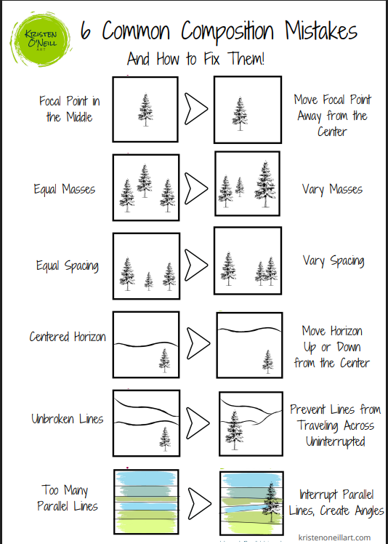

Slide 14
Composition cont’d
Basic Master Composition Rules for Artists
1. Rule of Thirds
The most basic composition rule is the “Rule of Thirds”. As can be expected from the name, this rule divides the composition into thirds, creating a 9×9 grid.
The composition principle that is at most play here is the principle of balance. Dividing the all over composition into thirds creates a balanced arrangement that both looks very stable and is striking in the viewer’s eye.
Notes:
Of course these are only guidelines to help you establish a coherent composition. Sometimes rules are meant to be broken. However, to successfully break the rules you must understand them first!

Slide 15
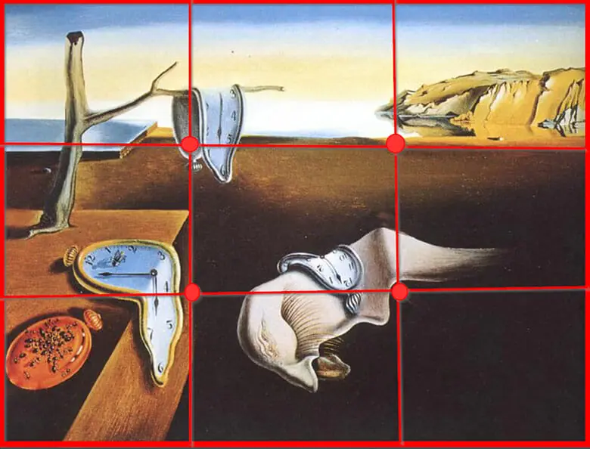
Example of The Rule of Thirds

Slide 16
The Golden Triangle Rule
The next rule is the “Golden Triangle”. It’s similar to the rule of thirds in that it relies on lines. But, rather than placing the subject along the vertical or horizontal line, the golden triangle rule places the focal point along a diagonal line.
To be more specific, with the “Golden Triangle”, the composition is cut into two by a diagonal line, and along that line, at 90 degree angles, two triangles are created.

Slide 17
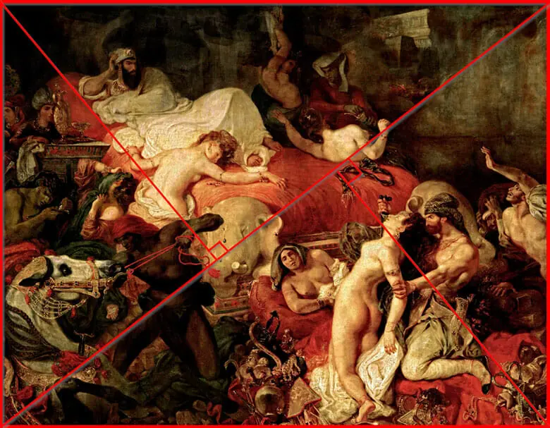
Example of The Golden Triangle Rule

Slide 18
Rule of The Golden Ratio
The golden ratio, also called the “Golden Spiral” or the “Fibonacci Sequence” is perhaps the most mysterious rule. At least, it looks very mysterious! However, even if it looks difficult at first glance, there’s no denying the appeal of the naturally created pattern of this arrangement.
It’s a bit hard to describe it in words, but the basic gist of this composition relies on the spiral that sparks movement. It brings energy to the composition and draws the line of sight towards the central point of the arrangement.

Slide 19
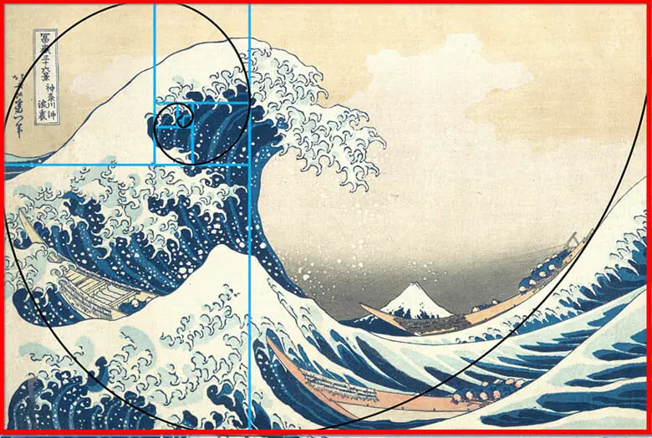
Example of the Rule of The Golden Ratio

Slide 20
Rhythm
Rhythm is created by repeating visual elements such as lines, shapes, or colors. This can create a sense of flow and energy within a composition.
It leads the viewer’s eye through the composition, emphasizing specific elements and guiding their gaze. Rhythm also elicits emotional responses, such as calmness or excitement, based on how it’s used alongside other elements in the artwork.

Slide 21
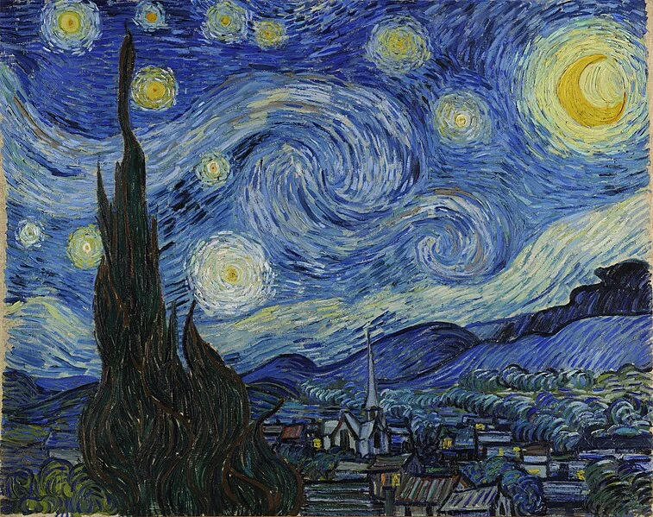
Example of Rhythm
Notes:
Good reference:
https://www.21-draw.com/composition-in-art/

Slide 22
Looking Ahead
How do we create a pleasing work of art using the principles just discussed?
We will look at some of the most famous artists who ever lived and discover how they used these ideas to create works which have inspired artists and people for ages. Then we will learn how to use simple tools to create great compositions of our own.

Slide 23
Putting This Knowledge to Work
This brings us to the concept of Dynamic Rectangles, symmetry and harmony.
Dynamic rectangles, also known as "root rectangles", are used in art design to create visually pleasing and harmonious compositions by providing a structured framework based on mathematical proportions, allowing artists to strategically place elements within their artwork to guide the viewer's eye and enhance the overall sense of movement and balance within the piece; essentially, it helps create a more natural and organic flow in the design, making it appear aesthetically appealing.

Slide 24
How Does One Use a Dynamic Rectangle To Produce a Well Composed Work of Art?
This is a good question, which leads to an important concept in art. The notion of functional space. Let’s begin by examining the types of Symmetry and Dynamic Rectangles.
Notes:
Look at the main diagonal on the Mona Lisa to clarify the idea of functional space.

Slide 25
Math in Art and Literature:
Fact or Fiction?
Do not panic! You will not need any math background here!
“[In art]Perspective, proportion, and symmetry in any context are quantifiable.
Accordingly, art indeed possesses quantifiable aspects.”†
†Math and the Mona Lisa, B. Atalay

Slide 26
What is Symmetry?
Vitruvius’ Definition: of Symmetry “…a proper accord of the members with one another, each part related to the whole.”
Predominant Types of Symmetry in Art:
Static
Dynamic

Slide 27
Static Symmetry
vs.
Dynamic Symmetry

Slide 28
Static Symmetry
Static Symmetry is based on the pattern properties of regular two-dimensional figures such as the square and the equilateral triangle. Static Symmetry is not based on the organic structures found in nature. “Too much symmetry [such as found in static symmetry]…can have a negative emotional impact.”†
†Math and the Mona Lisa, B. Atalay

Slide 29
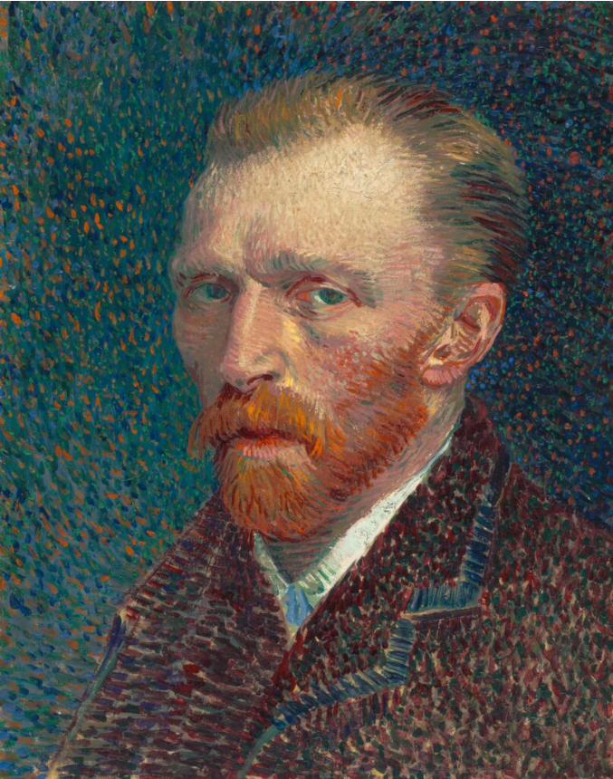
Example of Static Symmetry
Vincent van Gogh placed the eyes directly in the center of the artwork, so they catch your attention first. But the painting feels static. The story your mind creates is more about the subject and their internal feelings than the overall artwork.

Slide 30
Pleasing Symmetry
What is Dynamic Symmetry and why is it pleasing?
Why use Dynamic Symmetry in Art?
The origin of the Golden Section, or Divine Proportion
Are there other systems of dynamic symmetry, proportion utilized by the Old Masters?

Slide 31
Dynamic Symmetry
“The principles of design to be found in the architecture of man and plants have been given the name ‘Dynamic Symmetry.’ This symmetry is identical with that used by Greek masters in almost all art produced during the great classical period”†
Symmetry defines the relationship which the composing elements of form in a design, or an organism in nature, bear to the whole. In a design it is the thing which governs the just balance of the variety in unity. Dynamic symmetry is suggestive of life and movement.
†The Elements of Dynamic Symmetry, Jay Hambidge

Slide 32
The Golden Section
aka
The Divine Proportion
The Golden Ratio
Φ

Slide 33
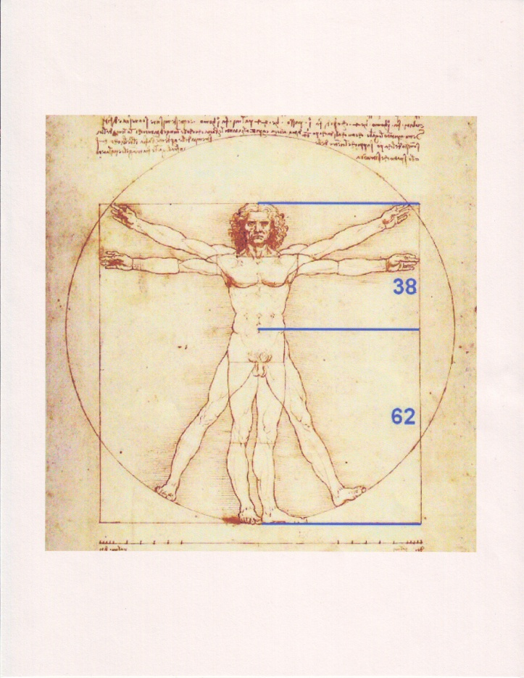
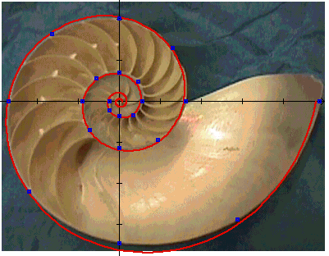
Examples of Divine Proportion
In Nature

Slide 34
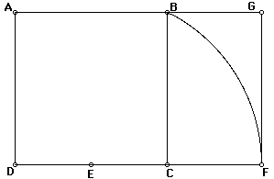
A Geometric Construction of the Golden Section Rectangle
11
11
√5/2
11
1/2
1/2
(√5 – 1)/2
Question: is DF:DC = DC:CF in order to satisfy Euclid?
DF:DC = (1 + √5)/2 = DC:CF
Hence: Φ = (1 + √5)/2 = 1.6180339887…
Notes:
Swing an arc from B using E as the center of the arc. The Golden Rectangle is A D F G. The ratio of DF/DC = 1.618 or Phi.

Slide 35
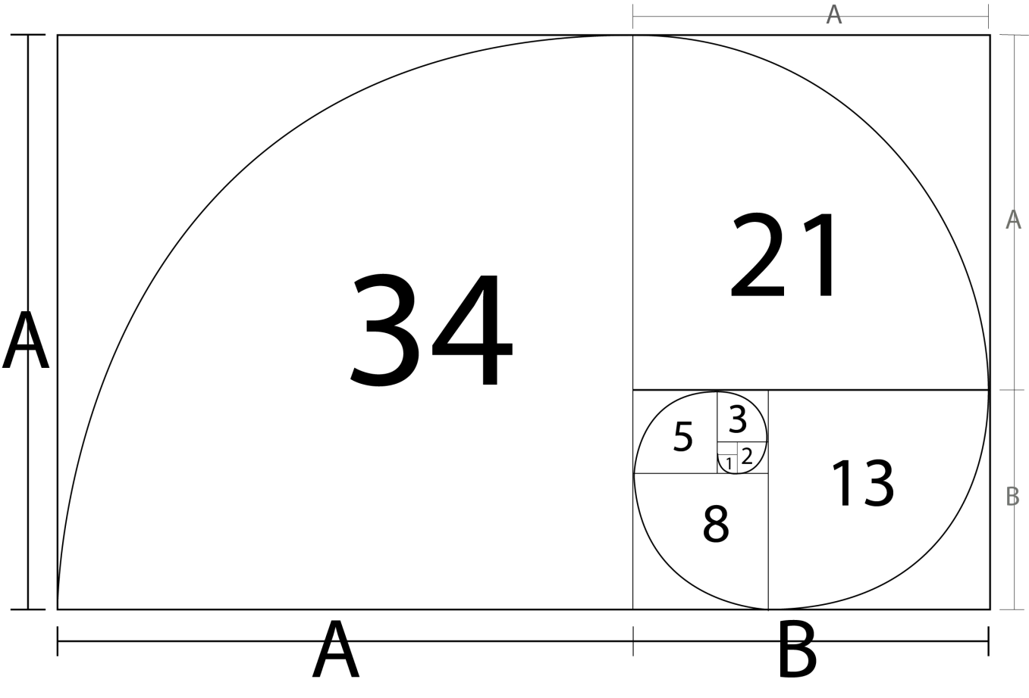
Golden Rectangle and Fibonacci Numbers
Fibonacci Sequence: 1, 1, 2, 3, 5, 8, 13, 21, 34, 55, … 196418, 317811…
Notice: 317811 /196418 = 1.618033989…

Slide 36
Beyond Divine Proportion
or
The other systems of Dynamic Composition
However, not all compositions lend themselves to the Golden ratio format. For example panoramic landscapes may look better in a long rectangular format. Luckily, there are other dynamic rectangles available.
The Root Rectangles
            Root Two
            Root Three
            Root Four
            Root Five
            Root Φ

Slide 37
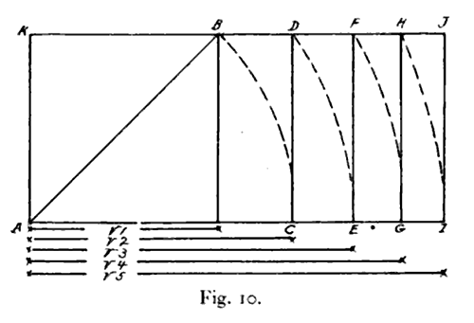
Beyond Divine Proportion
or
The other systems of Dynamic Composition
The Construction of the Root Rectangles

Slide 38
How Does One Choose a Dynamic Rectangle for Your Particular Work of Art?
Look at the subject of your drawing/painting. Look for a Dominant Diagonal. Use the angle formed by this line to determine the appropriate rectangle. This will become clear shortly.
Let’s look at a famous example. But first we must look at one more feature of Dynamic Rectangles.
Notes:
Look at the main diagonal on the Mona Lisa to clarify the idea of functional space.

Slide 39
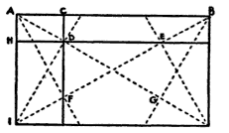
Root Three Armature
Notes:
Relate to Parrish work

Slide 40
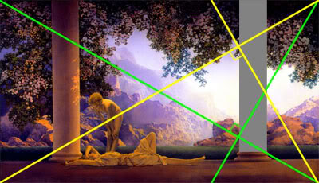
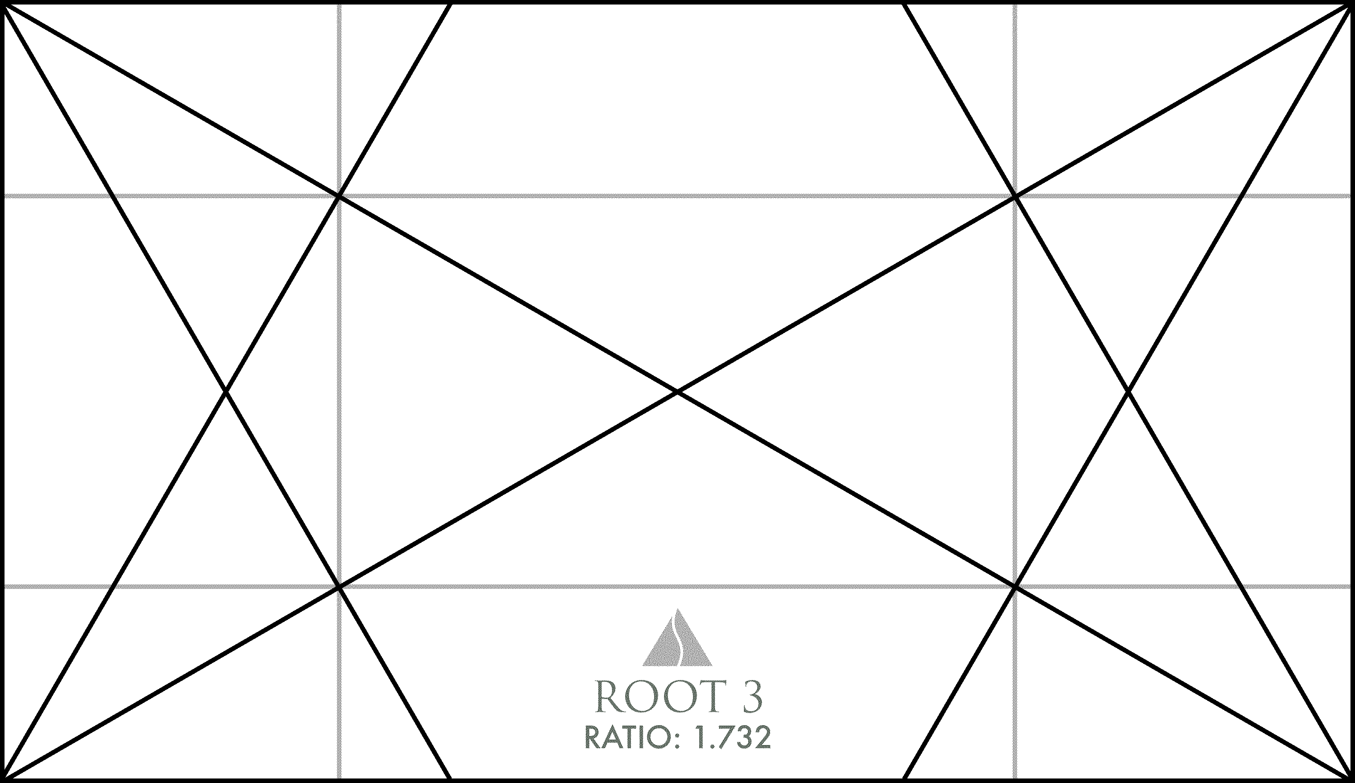
Classic Root 3 Example
“Daybreak”, by Maxfield Parrish
Notes:
Rule of Thirds

Slide 41
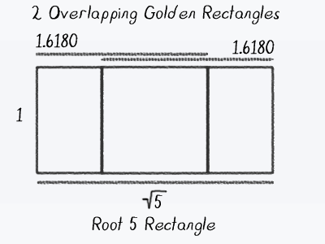
Any Dynamic Rectangle may be overlapped (known as “rabatment”) to produce a proper functional space.

Slide 42
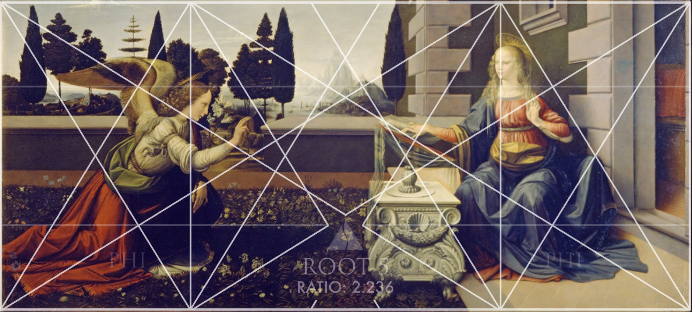
A Famous Root 5 Example
DaVinci’s “Annunciation”

Slide 43
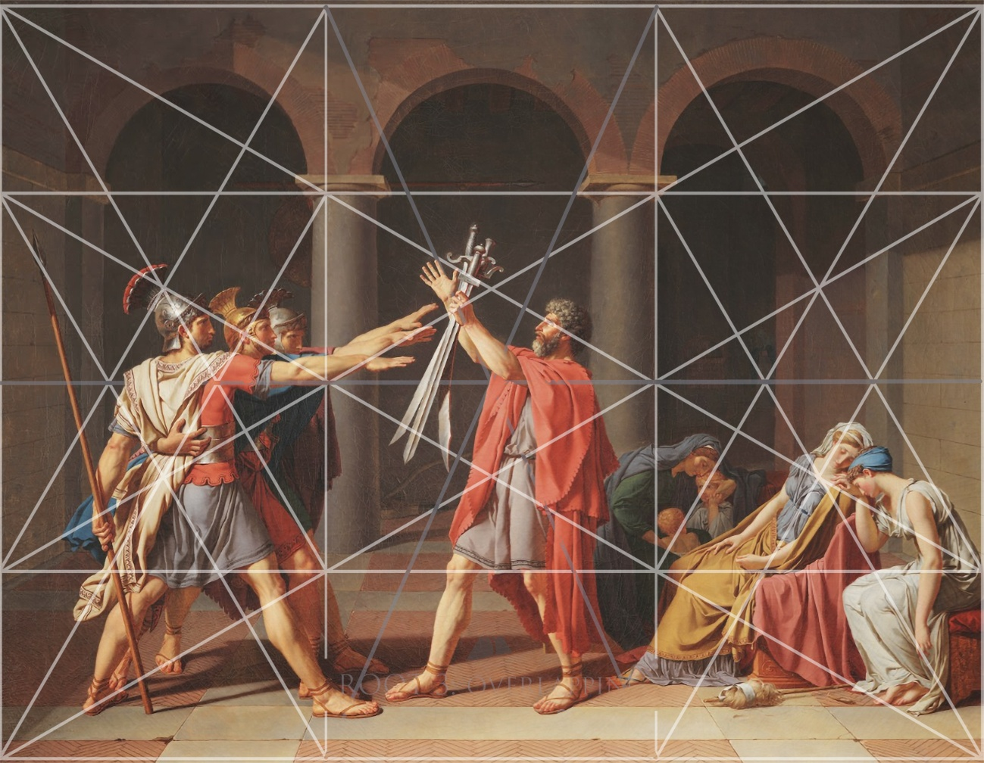
A Classic Root 3 Rabatment
“The Oath of the Horatii” by Jacque Louis David
Notes:
Rule of Thirds

Slide 44
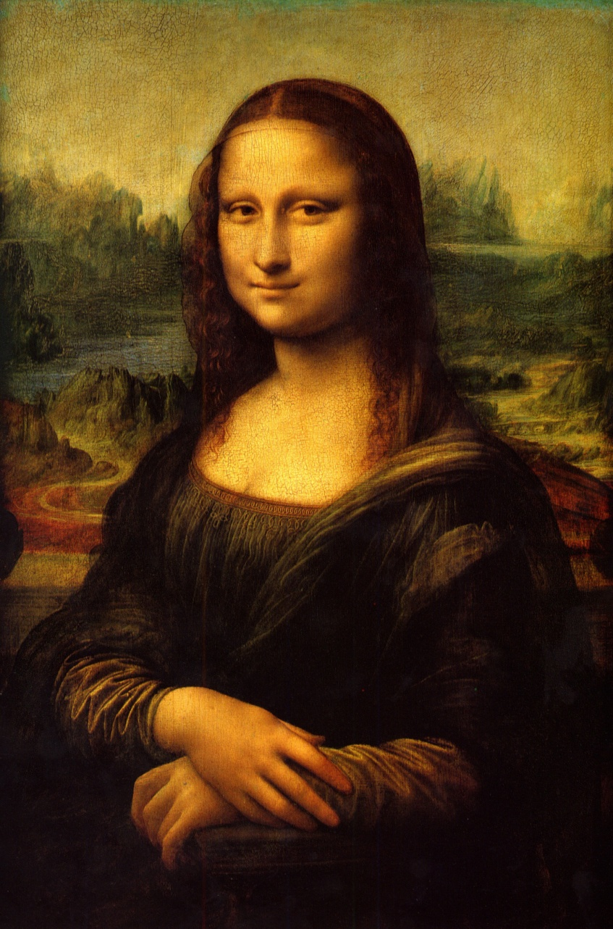
The Most Famous Example of Rabatment

Slide 45
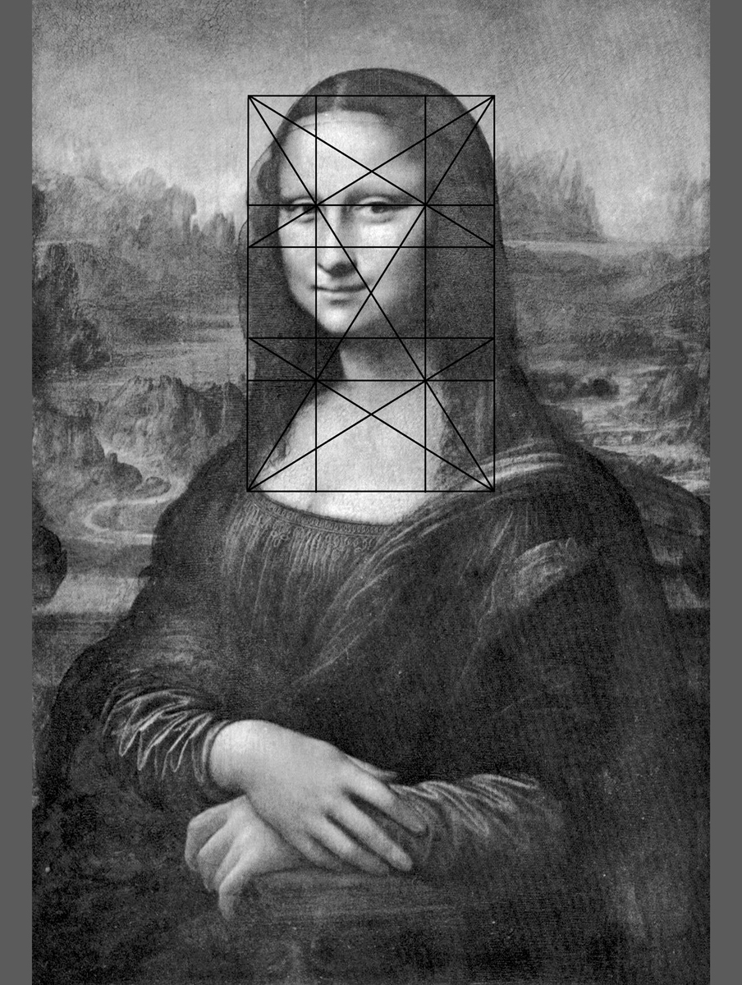
Mona Lisa
Why was the Golden Rectangle placed there?
Notes:
Mario Livio claimed “the Golden Ratio is supposed to be found in the dimensions of a rectangle around Mona Lisa’s face. In the absence of any clear (and documented) indication of where precisely such a rectangle should be drawn, this idea represents just another opportunity for number juggling.” Is he right?

Slide 46
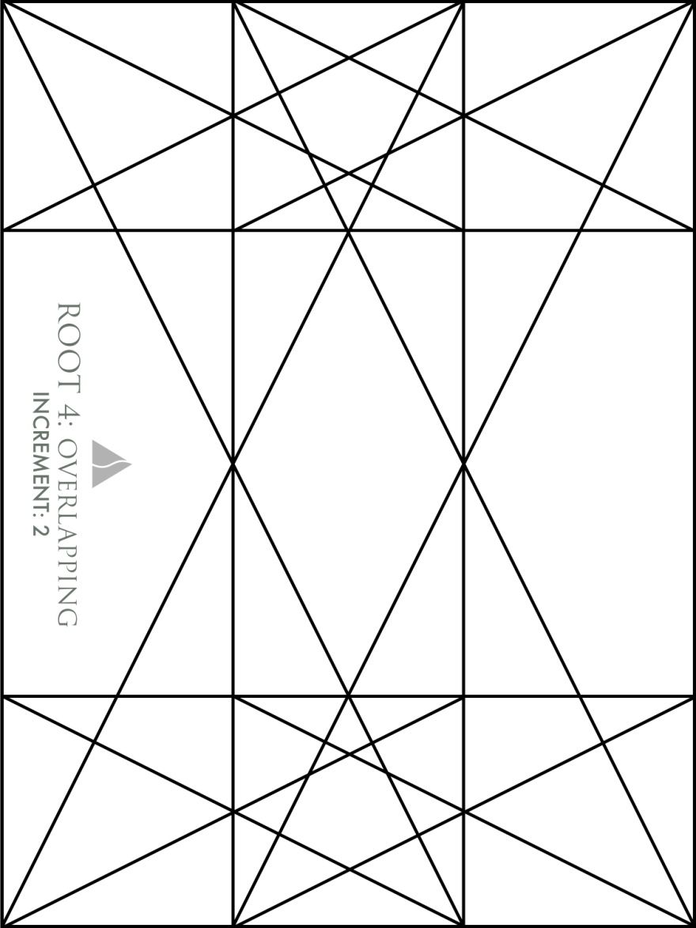
Root 4 Rabatment

Slide 47
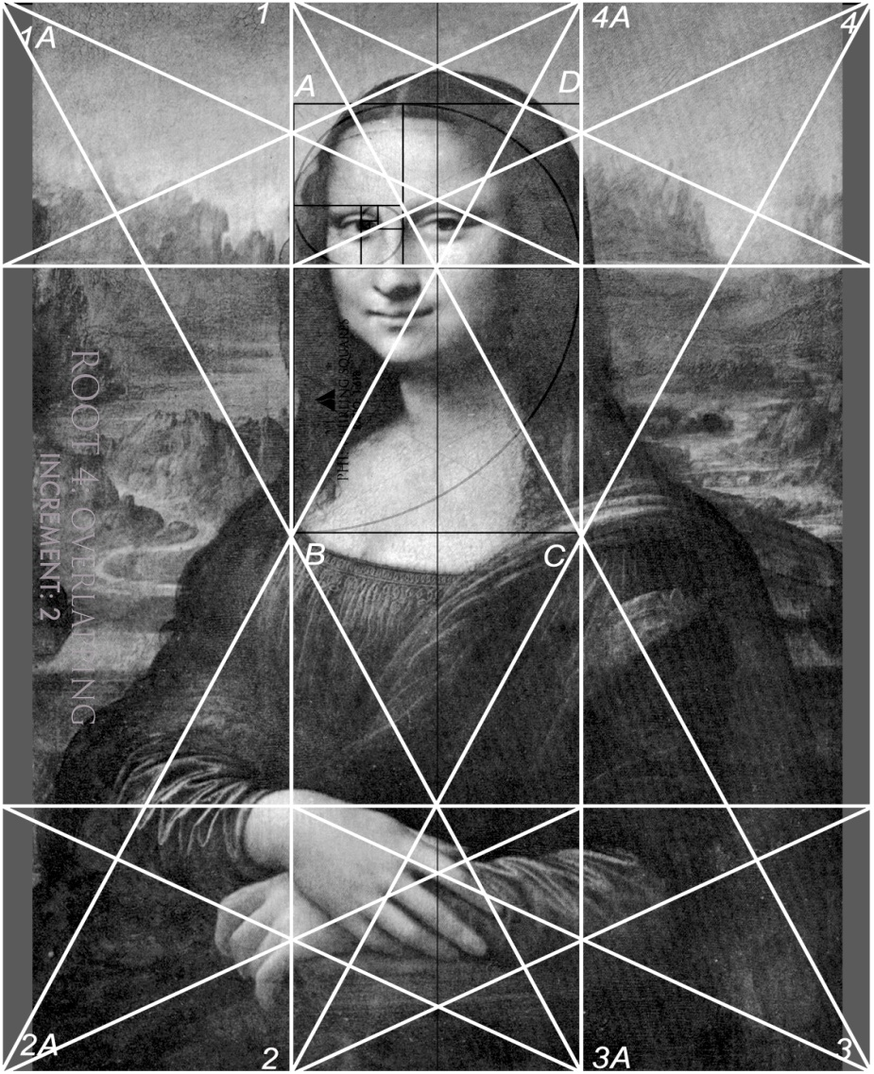
Mona Lisa Decoded (finally)!
Composition using the “rabatment”
Of two root four rectangles
Notes:
This illustrates the idea of functional space and the use of the Golden Section.
The dimensions of the painting are height: 77 cm; length: 53 cm (from the Louvre website). This ratio of width to height (1:1.45) does not correspond to any of the standard root rectangles and is certainly not a Golden Ratio rectangle. No proper overlap or concatenation of root rectangles could be found to create a rectangle with the ratio computed utilizing the dimensions of the Mona Lisa. Something was missing, literally. The answer was presented in Prof. Christopher Whitcombe’s paper, Da Vinci's Code, Leonardo's Life, Art, and Writings where he stated “[The painting] became part of the French royal collection [on DaVinci’s death] and was later trimmed by about an inch on either side [italics mine].” If the missing inch is added to each side of the painting, two √4 rectangles may be overlapped (see the figure above) and form the outer boundary of the painting. Notice, the diagonal of the root 4 rectangles form the DOMINANT DIAGONAL for the composition! The shape 1, 2, 3 and, 4, defines one of the rectangles. The second rectangle is defined by the shape 1A, 2A, 3A and, 4A. The rectangle formed by A, B, C, and D is a Golden Ratio rectangle, which may be subdivided to locate every feature of the face. For example the chin, the bottom of the neck, the bodice of the dress the width of the head (including the hair) can all be located on a subdivision of the rectangle A, B, C, D. In addition, this analysis may be continued by subdividing the two √4 rectangles. The results are astonishing. Every major feature of the painting lies on a subdivision of these rectangles. Notice: There are 6 root four rectangles. 1, 4A, C, B form a root four rectangle. Rectangle A, B, C, D is a Golden Section rectangle which fits perfectly into the root four.
This lack of correspondence to any root rectangle puzzled Bulent Atalay, author of “Math and the Mona Lisa”. See page 176. “The proportions of the “Mona Lisa” panel are about 1:1.45, not particularly close to the Golden ratio of 1:1.618, though the earlier trimming of the painting on its sides makes this test meaningless for us.” Unfortunately, he must have never studied what we have learned here. He makes, as well as many others, wild guesses an incorrect assumptions about DaVinci’s composition. Leonardo was the consummate scientist. There was a mathimatical reason why the woman’s face was placed exactly where it is on the canvas!

Slide 48
End Part 1

Slide 49
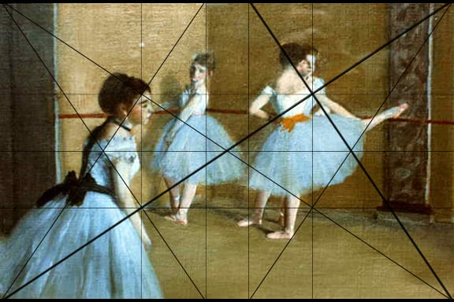
More Famous Examples
Degas: Part of “Dancing Class at the Opera” 1.5 Rectangle
Notes:
Look at the main diagonal on the Mona Lisa to clarify the idea of functional space.

Slide 50
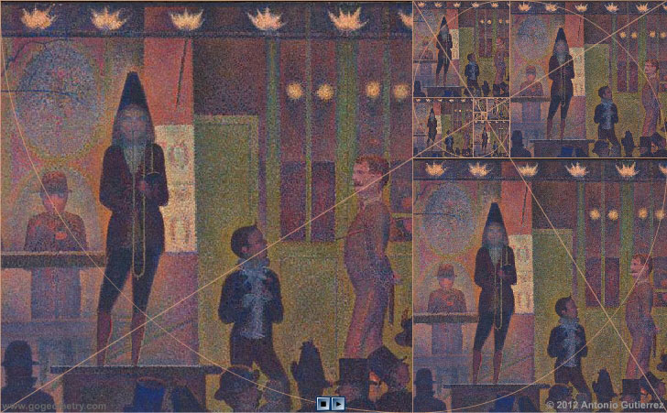
Another Famous Example
Seurat "attacked every canvas by the golden section". His The Side Show has obvious golden subdivisions.

Slide 51
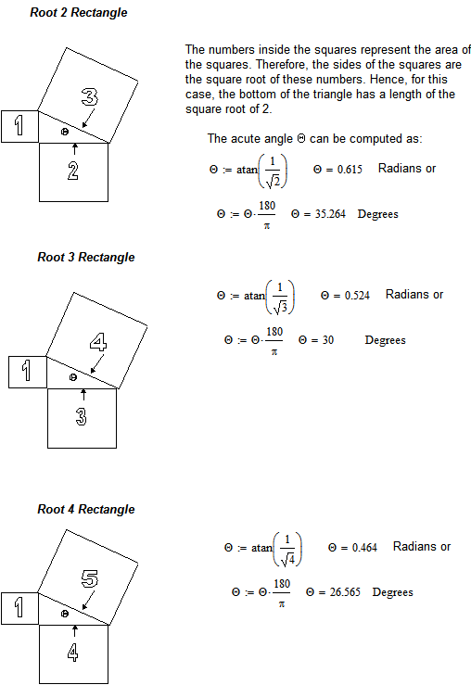
Easy Method of constructing Root Rectangles. No math required.
Notes:
Mathematically this is the meaning of the term “root rectangles”. The numbers inside the squares represent the area of the squares. Therefore, the sides are the square roots of the area. Hence the name Root Rectangles. All you really need to remember is the rectangle you wish to use for your art work, given the chosen functional space, and the angle theta. More on this in a minute.

Slide 52
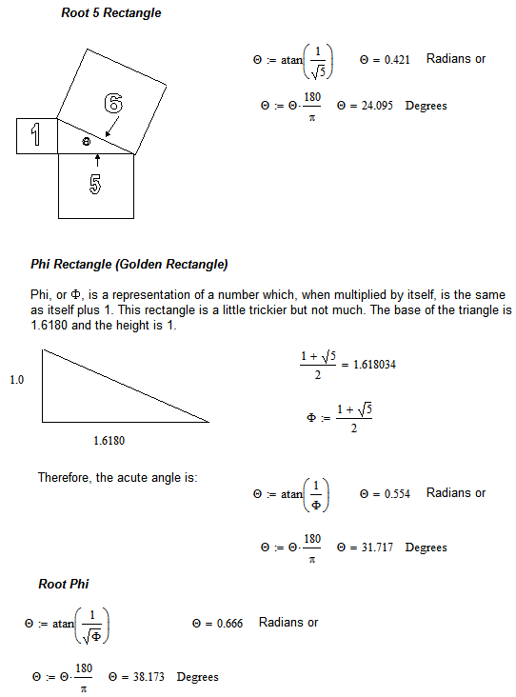
Mathematics of the Rectangles

Slide 53
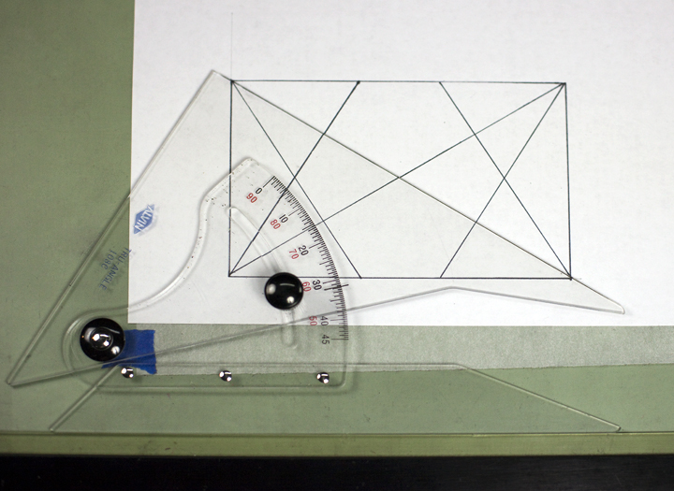
Relieving Math Anxiety,
or a Simple Construction Technique:
Φ Rectangle

Slide 54
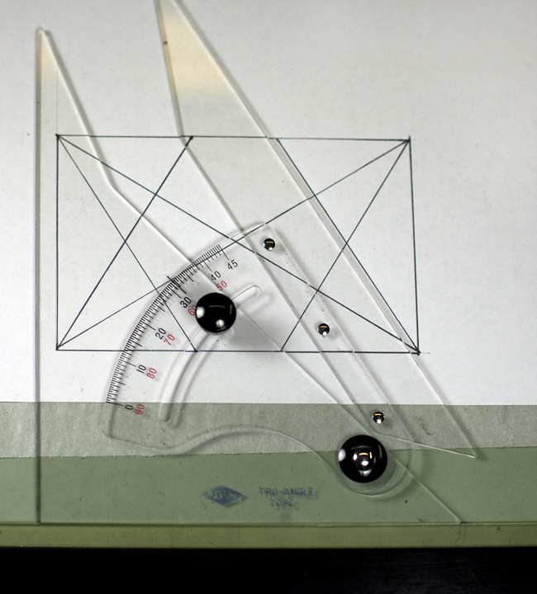
Relieving Math Anxiety,
or a Simple Construction Technique

Slide 55
2 Examples of Divine Proportion
In Architecture
Was the Great Pyramid constructed on the Golden Ratio?
Assuming that the height of the GP = 146.515 m, and base = 230.363 m, and using simple math we find that half of the base is 115.182 m and the "slant height" is 186.369 m
Dividing the "slant height" (186.369m) by "half base" (115.182m) gives = 1.618039277, which is less than 0.001 % of Φ! While some authors dispute the idea of the pyramids being built with Φ in mind, a 0.001% error leaves little to be doubted. However, there is still considerable debate surrounding the construction of the Parthenon.

Slide 56
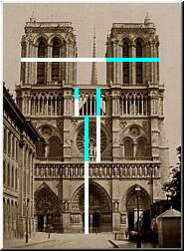
Divine Proportion
In Architecture

Slide 57
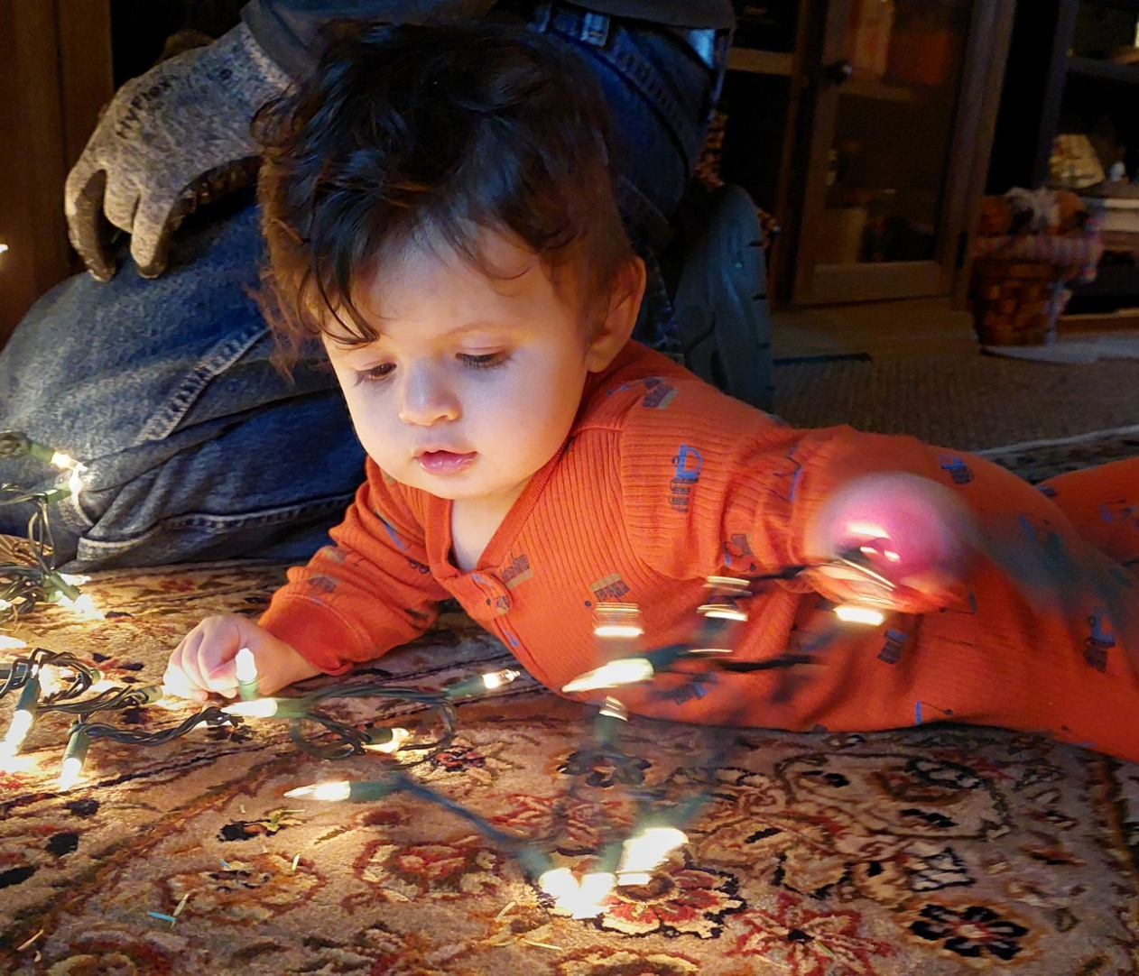
Personal Example of the Process
Original Photo

Slide 58

Isolate Subject

Slide 59

Choose Appropriate Rectangle:
Overlapping Phi Rectangles to form a Square
Notes:
You may have to adjust angle, remove unwanted features.

Slide 60

Create Final Pastel Portrait
Notes:
You may have to adjust angle, remove unwanted features.

Slide 61
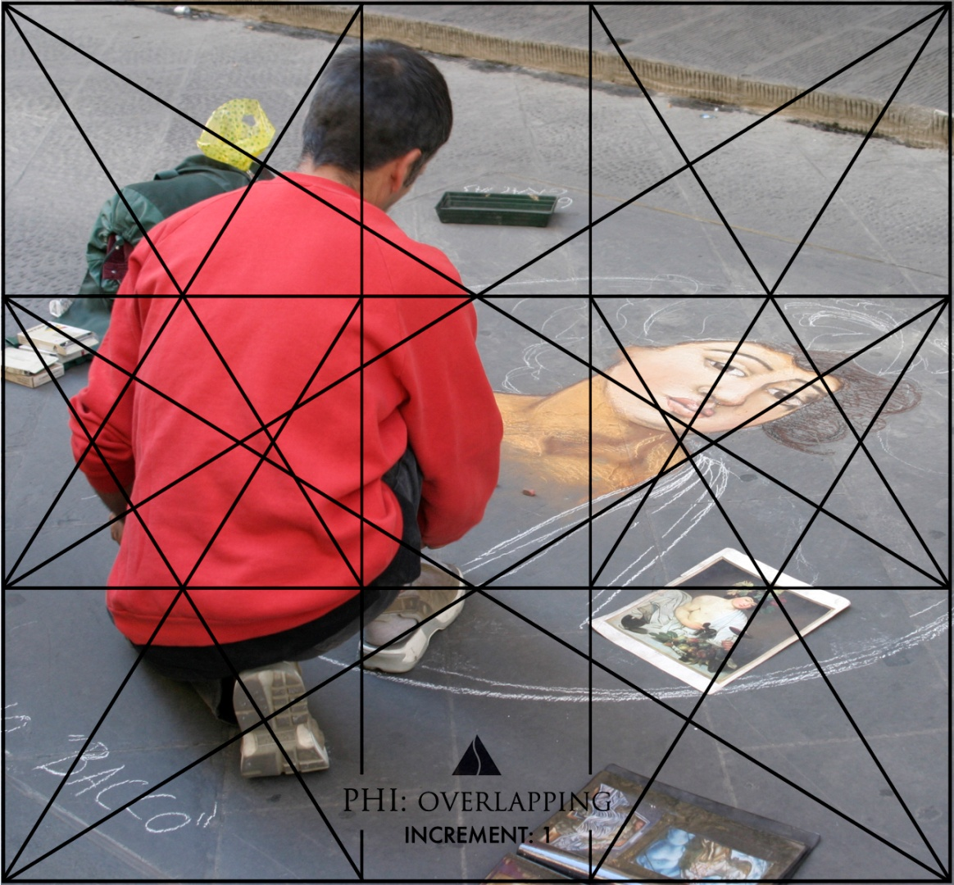
Additional Example

Slide 62
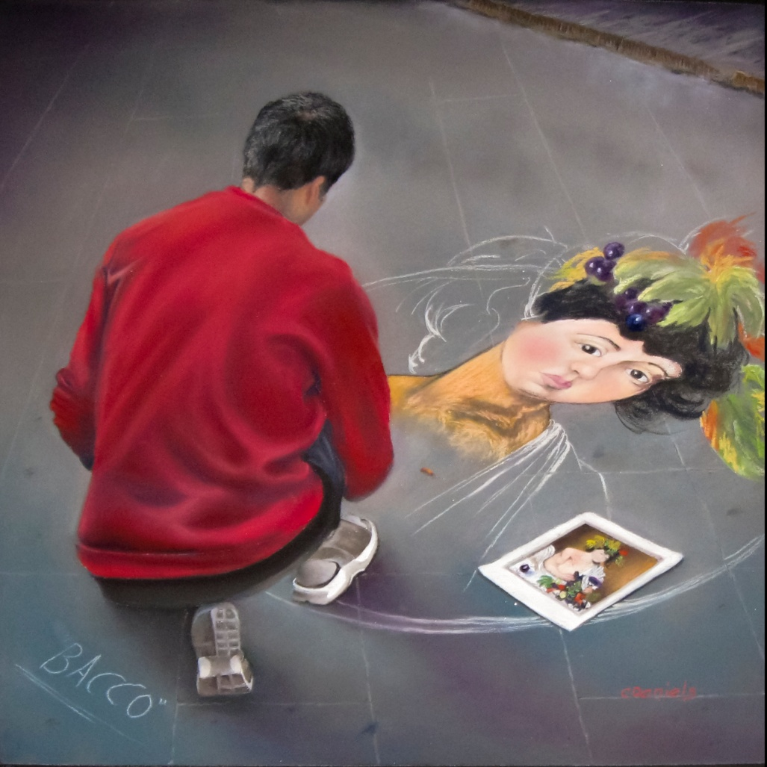
Finished Product

Slide 63
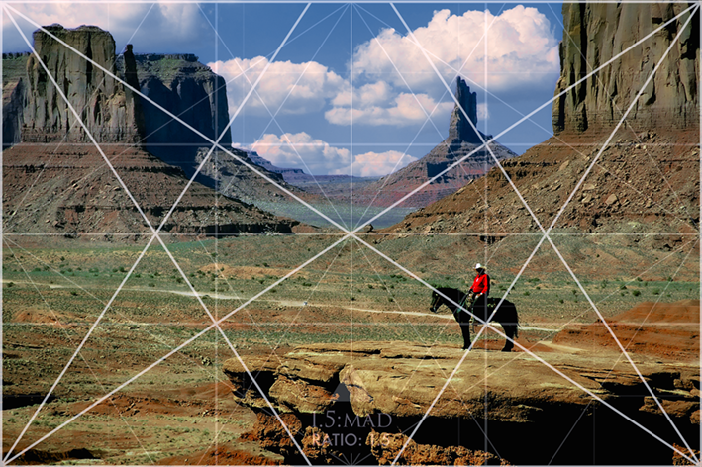
Additional Example
Original photo
Notes:
Rectangle is a root phi

Slide 64
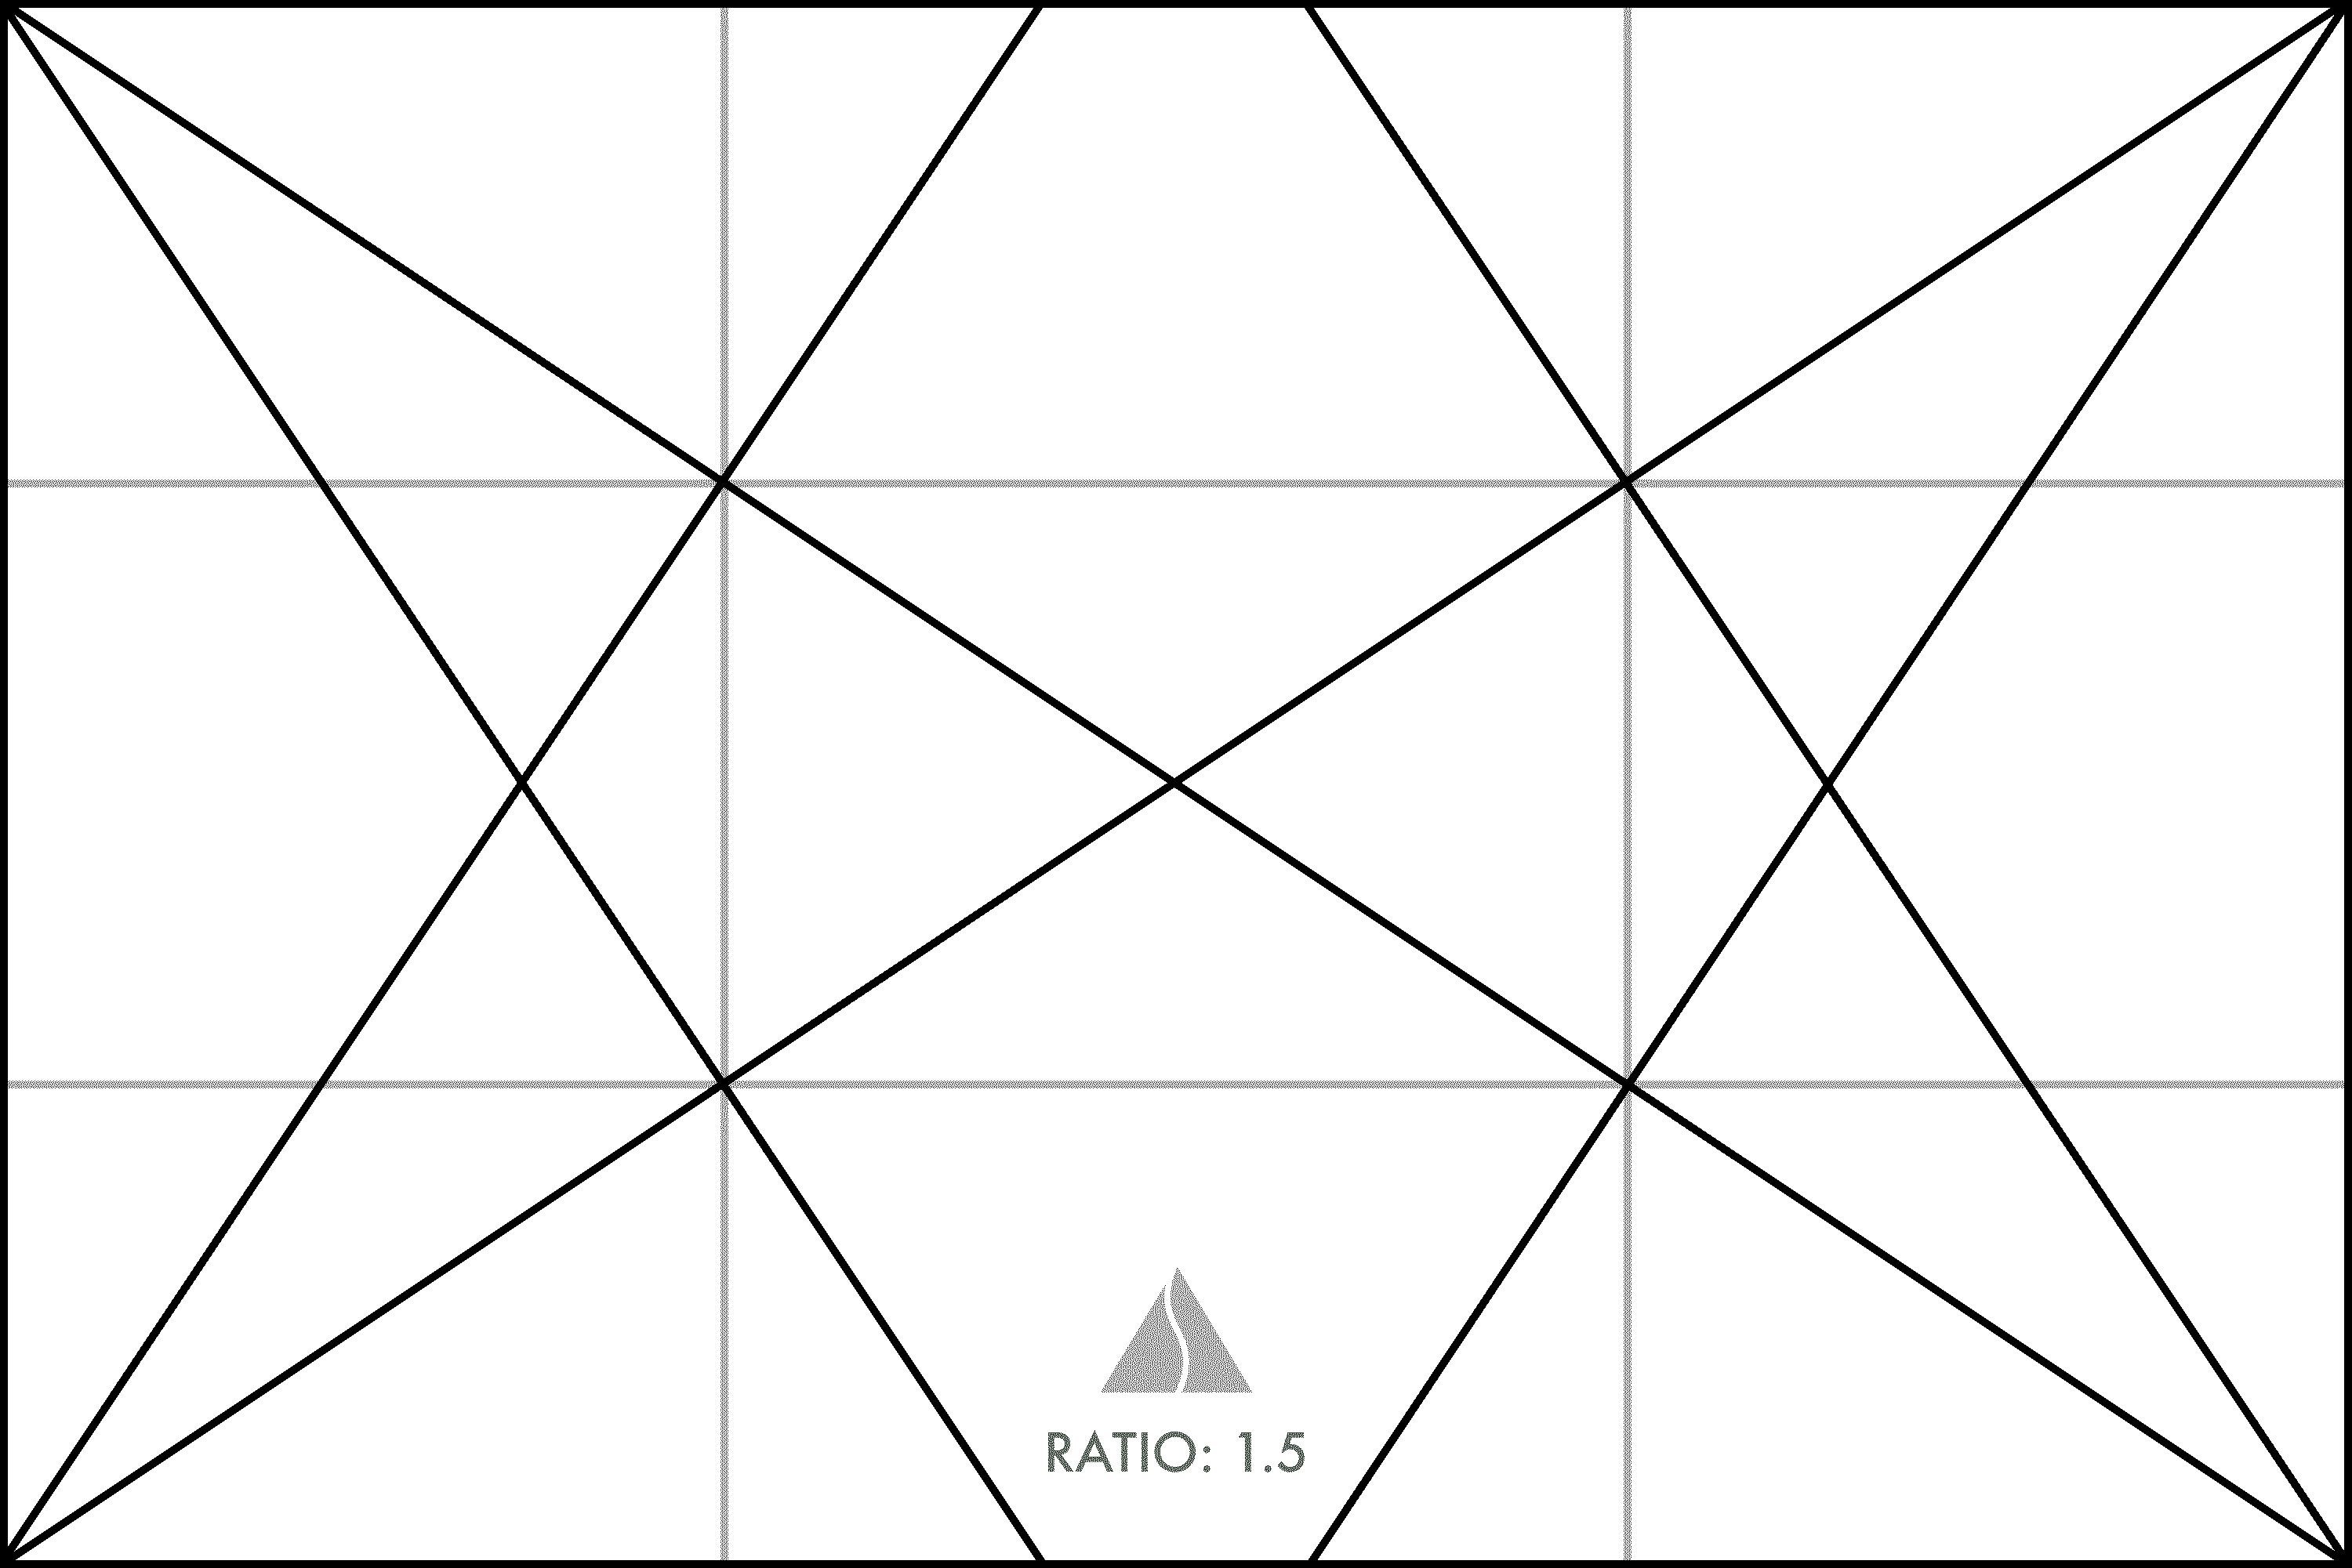

Finished Product

Slide 65
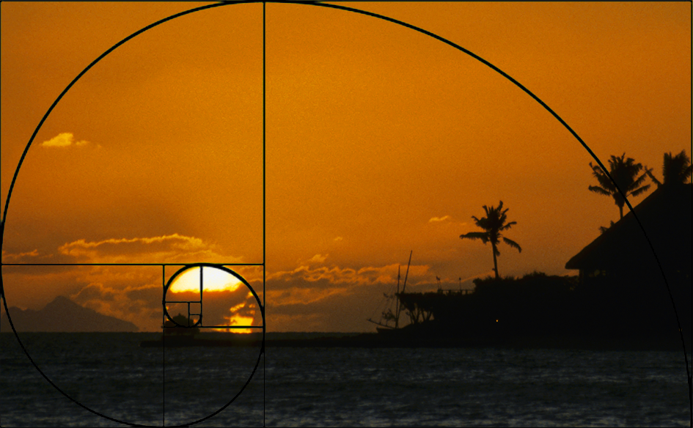
Additional Example
Notes:
Phi rectangle and Golden Spiral

Slide 66

Finished Product

Slide 67
Summary
We have defined Dynamic Symmetry and shown how math is used in art
Why was/ is it used?
The Divine Proportion is NOT the only dynamic system used in art and architecture. The choice of symmetry depends on the functional space the artist chooses for his work
The presence of the Golden Ratio in old art and architecture has been debated for years. Is it really there or is it fiction? The evidence is too overwhelming. It is fact!
A simple construction technique was shown, which can relieve the math anxiety for the math averse.
Notes:
Why use dynamic symmetry? A young local art student Ryan Brooker of Tennessee described the creative process most succinctly when he said: “True freedom comes from discipline using classical techniques of design. When you have limits you are forced to organize your design and think more about what you are doing.” Kenyon Cox echoed this young man’s words when he wrote, “Without design there may be representation…but there can be no art.”
Another famous Renaissance man, a contemporary of Alberti and DaVinci, Luca Pacioli and published the De Divina proportione in 1509. In it he refers to the golden ratio as heaven-sent. Why does he call the golden ratio divine?
1. Like God, it is unique.
2. As the Trinity is one substance in three persons, the divine proportion is a single proportion in three terms.
3. As God cannot be described in words, the divine proportion cannot be expressed by a rational number. It is occult and secret.
4. Like God it is always similar to itself. After centuries of oral transmission, the golden ratio was finally succinctly expressed by Pacioli.

Slide 68
Hints for Landscapes
When it comes to painting landscapes, your sketch can make or break your work. That’s why I always suggest sketching them first.
Here’s how sketching your landscapes first sets you up for success when you paint it:
🌳 It simplifies the structure​
Sketching trees as shapes and masses, not details keeps things manageable and gives you a strong foundation.
🌳 It helps you to train your eye with light and shadow​
Sketching your landscape first helps you to observe how light, shadow, and texture interact. These quick studies prepare your hand and eye before color comes into play.
🌳 It's easier to paint when your sketch is good​
When you move to paint, the groundwork is already done. Your trees will stand firmly in your landscapes because your sketch has guided the composition.

Slide 69
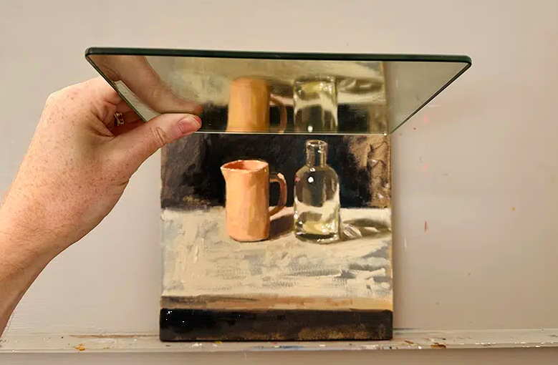
Use a Mirror to check for symmetry and proportion

Slide 70
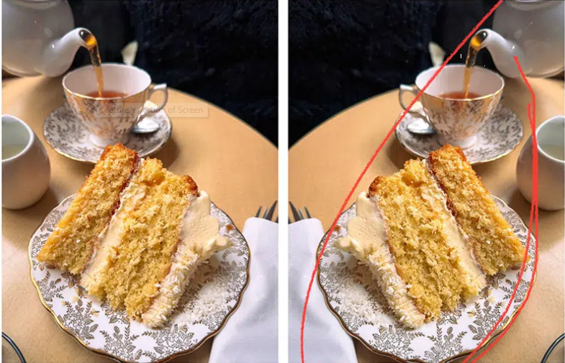
Check Mirror Image

Slide 71
What About Framing?
5x7 – Root 2
8x10
9x12
12x16
11x14 – Root Phi
12x24 – Root 4
16x20
18x24
24x36

Slide 72
What About Framing?
Notice, very few standard size frames are dynamic root rectangles. Perhaps, some combination (overlay of rectangles may work). Custom frames are expensive. However, here is an online link to a rather inexpensive frame shop that I have found excellent. https://www.framedestination.com/

